Slide 1
Trees
A tree is a connected undirected graph with no simple circuits.
A tree cannot have a simple circuit, so a tree cannot contain multiple edges or loops.
Any tree must be a simple graph.

Slide 2
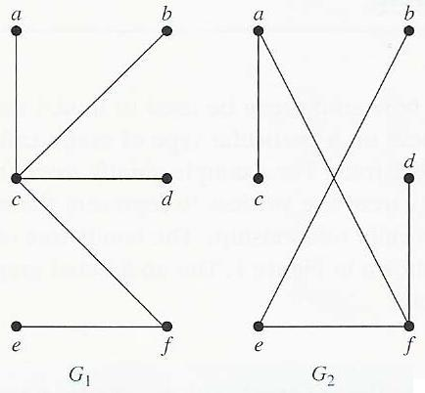
Example: Trees
G₁ and G₂ are trees. Both are connected graph with no simple circuits.

Slide 3
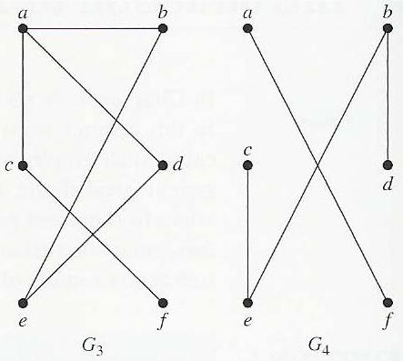
Example: Not Trees
G₃ is not a tree..
G₄ is not a tree.

Slide 4
Theorem: Let G be a graph with n nodes and e edges
  1.G is a tree (connected, acyclic)
  2. G is acyclic and e = n - 1
  3.G is connected and e = n - 1
  4.G is acyclic and if any two non-adjacent points are joined by an edge, the resulting graph has exactly one cycle
  5. G is connected, but if any edge is deleted, it will be non-connected
  6. Every two nodes of G are joined by a unique path

Slide 5

证明 (1)⇒(2)：n=2时候显然成立。假设n=k时候也成立，考虑n=k+1时，主要利用存在度小于2的点进行证明。
(2)⇒(3)：只需证T连通。若T不连通，不妨设有k个连通分支(k≥2)，分别记为T₁、T₂、…、T_{k}，T_{i}的结点数和边数分别记为n_{i}和m_{i}(i＝1，2，…，k)，则有
(i＝1，2，…，k)。于是， ，矛盾。所以T连通 。

Slide 6
(3)⇒(4)：只需证T的每条边都是割边。任取T的边e，则T－{e}的边数为m－1，结点数为n，于是m－1＝n－2＜n－1，所以T－{e}是不连通的，因而e是割边。故T的每条边都是割边。
(4)⇒(5)：由于T的每条边都是割边，因而T中无回路。在T中添加新边[u，v]，由T是连通的，则存在u到v的一条路Γ，于是Γ＋[u，v]构成一回路。若得到的回路不惟一，不妨记为Γ₁和Γ₂，则Γ₁－{[u，v]}与Γ₂－{[u，v]}构成一回路，其上的边都不是割边，矛盾。故在T中任意增加一条边产生惟一一条回路。

Slide 7
(5)⇒(6)：若T中存在两结点u和v之间不存在路，则添加边[u，v]不产生回路，矛盾。所以T中任意两个结点之间存在路。若u和v之间存在两条不同的路Γ1和Γ2，则Γ1和Γ2形成回路，矛盾。所以T中每对结点间恰有一条路。
(6)⇒(1)：因为T中每对结点间恰有一条路，所以T是连通的。若T有回路，则回路上的任意两个结点之间存在两条路，矛盾，所以T没有回路。因此，T是树。

Slide 8
Theorem: there exists at least two leaves for every non-trival tree.

Slide 9
Forest
A graph containing no simple circuits that are not necessarily connected.
A Forest : a graph with the property that each of their connected components is a tree.

Slide 10
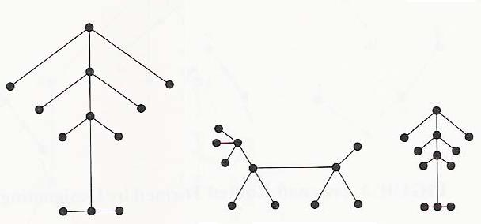
Example: Forest
A one graph with three connected components

Slide 11
In many applications of trees, a particular vertex of a tree is designated as the root. Once we specify a root, we can assign a direction to each edge as follows: direct each edge away from the root.
Thus, a tree together with its root produces a directed graph called a rooted tree.

Slide 12
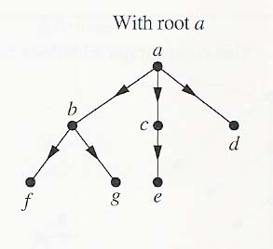
A Rooted Tree

Slide 13
Rooted Trees
We can change an unrooted tree into a rooted tree by choosing any vertex as the root.
Different choices of the root produce different trees.

Slide 14
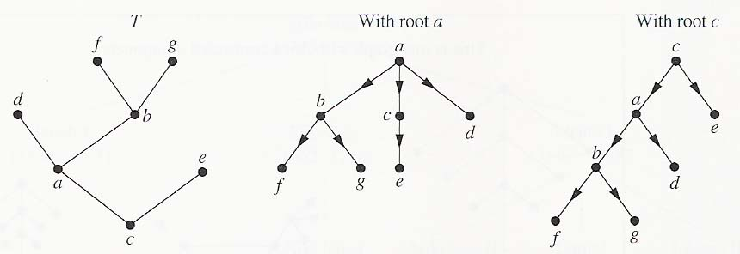
Example: Rooted Trees
The rooted trees formed by designating a to be the root and c to be the root, respectively, in the tree T.

Slide 15
The Terminology for Trees
Suppose that T is a rooted tree. If v is a vertex in T other than the root.
The parent of v is the unique vertex u such that there is a directed edge from u to v.

Slide 16
The Terminology for Trees
When u is the parent of v, v is called a child of u.
Vertices with the same parent are called siblings.

Slide 17
The Terminology for Trees
The ancestors of a vertex other than the root are the vertices in the path from the root to this vertex, excluding the vertex itself and including the root.
The descendants of a vertex v are those that have v as an ancestor.

Slide 18
The Terminology for Trees
A vertex of a tree is called a leaf if it has no children.
Vertices that have children are called internal vertices.

Slide 19
The Terminology for Trees
If a is a vertex in a tree, the subtree with a as its root is the subgraph of the tree consisting of a and its descendants and all edges incident to these descendant.

Slide 20
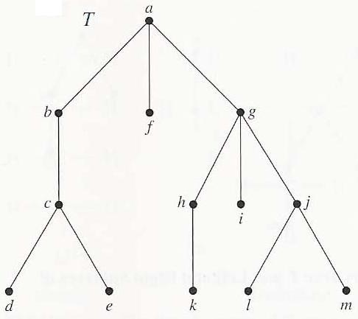
Example: Using Terminology
T is a rooted tree with root a.
The parent of vertex c is b.
The children of g are h, i, and j.

Slide 21
Example: Using Terminology
The siblings of h are i and j.
The ancestors of e are c, b, and a.
The descendant of b are c, d, and e.

Slide 22
Example: Using Terminology
The internal vertices are a, b, c, g, h, and j.
The leaves are d, e, f, i, k, l, and m.

Slide 23
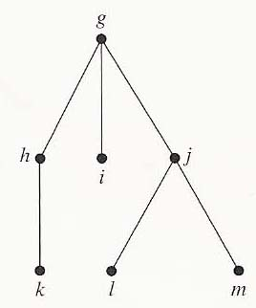
Example: Using Terminology
The subtree rooted at g is

Slide 24
m-ary Tree
A rooted tree is called an m-ary tree if every internal vertex has no more than m children. The tree is called a full m-ary tree if every internal vertex has exactly m children. An m-ary tree with m = 2 is called a binary tree.

Slide 25
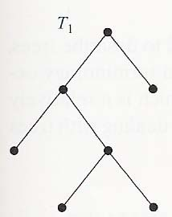
Example of m-ary tree
T₁ is a full binary tree.
Each of its internal vertices has two children

Slide 26
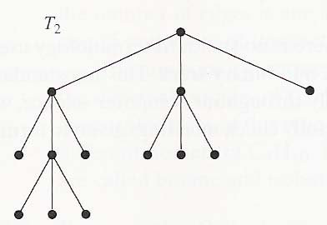
Example of m-ary tree
T₂ is a full 3-ary tree.
Each of its internal vertices has three children

Slide 27
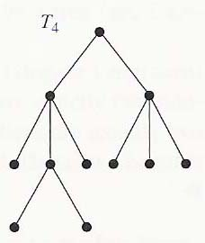
Example of m-ary tree
T₄ is not a full m-ary tree for any m.
Some of its internal vertices has 2 children and others have 3.

Slide 28
Ordered Rooted Tree
An ordered rooted tree is a rooted tree where the children of each internal vertex are ordered.
In an ordered binary tree, if an internal vertex has two children, the first child is called the left child and the second child is called the right child.
The tree rooted at the left child of a vertex is called the left subtree of this vertex, and the tree rooted at the right child of a vertex is called the right subtree of the vertex.

Slide 29
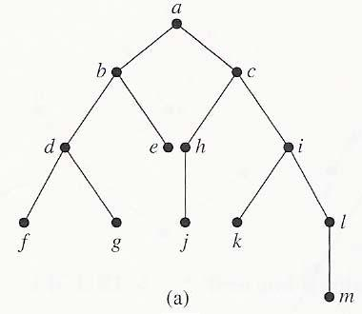
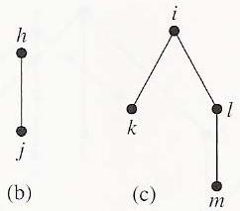
Example
The left child of d is f and the right child is g.
The left and right subtrees of c are

Slide 30
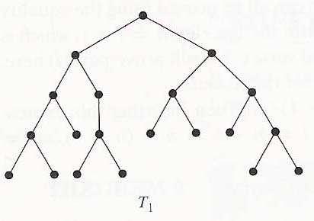
A rooted m-ary tree of height is balanced if all leaves are at levels h or h – 1.
T₁ is balanced.
All its leaves are at levels 3 and 4.

Slide 31
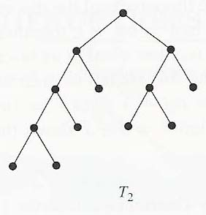
T₂ is not balanced.
It has leaves at levels 2, 3, and 4.

Slide 32
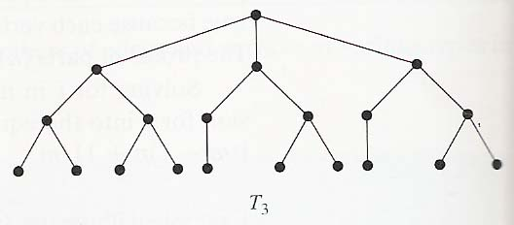
T₃ is balanced.
All its leaves are at level 3.

Slide 33
Properties of Trees
A full m-ary tree with i internal vertices contains n = mi+1 vertices.

Slide 34
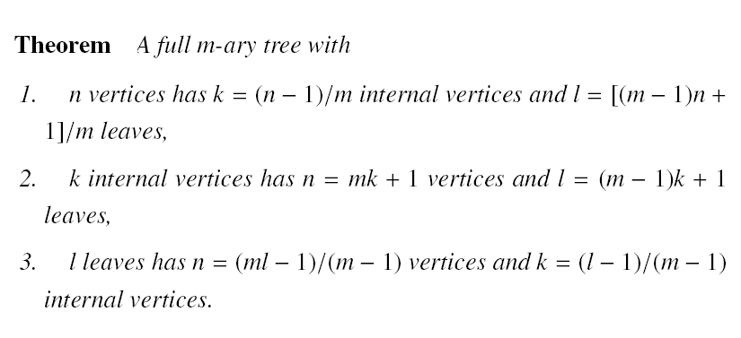
Theorem 4: A full m-ary tree with
1) n vertices has i = (n-1)/m internal vertices and
l = [(m-1)n+1]/m leaves
2) i internal vertices has n = mi + 1 vertices and
l = (m-1)i+1 leaves
3) l leaves has n = (ml-1)/(m-1) vertices and
i = (l-1)/(m-1) internal vertices

Slide 35
Tree Property 4
Proof for 1)
l: Number of leaves
k: Number of internal vertices
n: total number of vertices.
n = mk+ 1, and we have n = l + k
n = mk+ 1 => k= (n-1)/m
By subsitution in n = l + k
  l = n – k
  l = n – (n-1)/m
  [(m-1)n+1]/m

Slide 36
Tree Property 4
Proof for 2)
l: Number of leaves
k: Number of internal vertices
n: total number of vertices.
n = mk+ 1, and we have n = l + k
By subsitution in n = l + k
l + k= mk + 1
l = (m-1) k + 1

Slide 37
Tree Property 4
Proof for 3)
l: Number of leaves
k: Number of internal vertices
n: total number of vertices.
n = mk+ 1, and we have n = l + k
By subsitution of k in n = mk + 1
  n = m (n –l) + 1
  n (m -1) = (ml -1)
  n = (ml -1)/ (m -1)
By subsitution of n in k= n – l we have k = (l – 1)/(m – 1)

Slide 38
Properties of Trees
The level of a vertex v in a rooted tree is the length of the unique path from the root to this vertex.
level 2
level 3

Slide 39
Properties of Trees
The height of a rooted tree is the maximum of the levels of vertices.

Slide 40
Properties of Trees
Theorem:There are at most m^{h} leaves in an m-ary tree of height h.

Slide 41
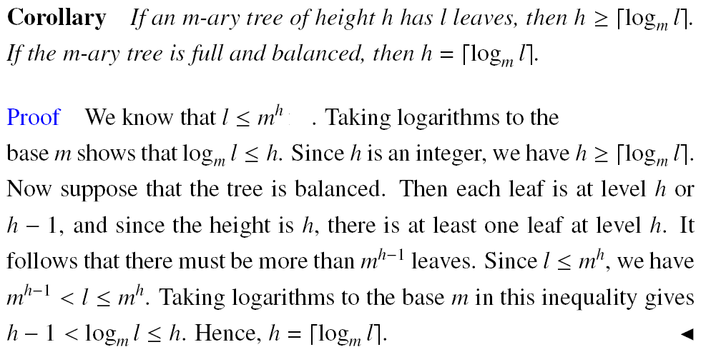

Slide 42
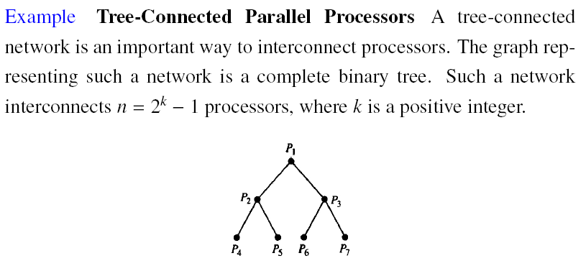

Slide 43
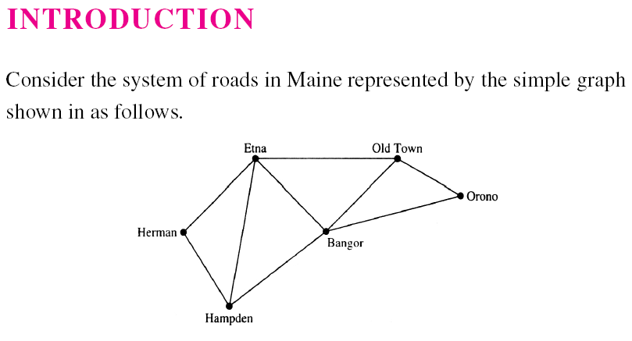
Spanning Trees

Slide 44
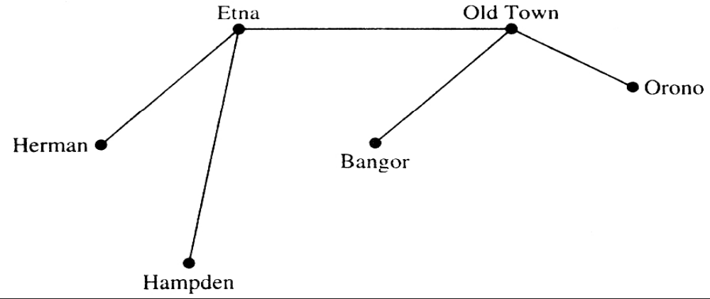
Note that the subgraph representing these roads is a tree, since it is connected and contains six vertices and five edges.

Slide 45
This problem was solved with a connected subgraph with the minimum number of edges containing all vertices of the original simple graph. Such a graph must be a tree.
Definition 1:Let G be a simple graph. A spanning tree of G is a subgraph of G that is a tree containing every vertex of G.

Slide 46
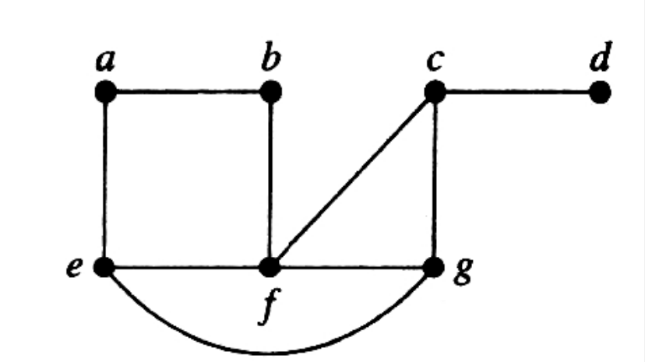
Example Find a spanning tree of the simple graphG shown as follows.

Slide 47
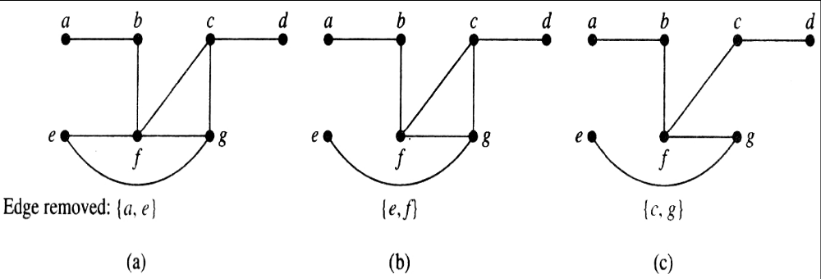

Slide 48
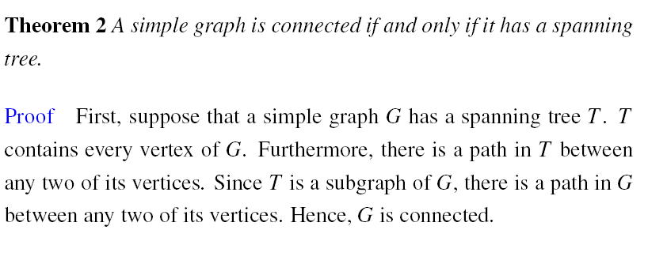

Slide 49
Example IP Multicasting ,With IP Multicasting, data to reach receiving computers as quickly as possible, there should be no loops in the path that data take through the network.
That is, once data have reached a particular router, data should never return to this router. To avoid loops, the multicast routers use network algorithms to construct a spanning tree in the graph that has the multicast source, the routers, and the subnetworks containing receiving computers as vertices, with edges representing the links between computers and/or routers.

Slide 50
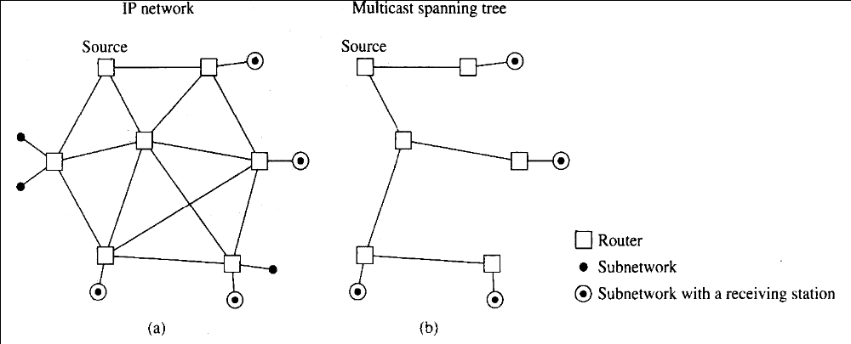

Slide 51
MINIMUM SPANNING TREES
  A company plans to build a communications network connecting its five computer centers. Any pair of these centers can be linked with a leased telephone line. Which links should be made to ensure that there is a path between any two computer centers so that the total cost of the network is minimized

Slide 52
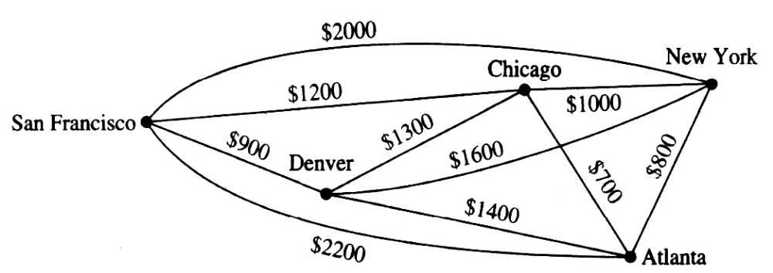

Slide 53
Minimum-cost spanning trees
Suppose you have a connected undirected graph with a weight (or cost) associated with each edge
The cost of a spanning tree would be the sum of the costs of its edges
A minimum-cost spanning tree is a spanning tree that has the lowest cost
16
A
B
16
21
11
6
A
B
11
6
19
5
F
C
5
33
14
F
C
10
E
18
D
E
18
D
A connected, undirected graph
A minimum-cost spanning tree

Slide 54
Minimum Spanning Tree (MST)
A minimum spanning tree is a subgraph of an undirected weighted graph G, such that
it is a tree (i.e., it is acyclic)
it covers all the vertices V
  contains |V| - 1 edges
the total cost associated with tree edges is the minimum among all possible spanning trees
not necessarily unique

Slide 55
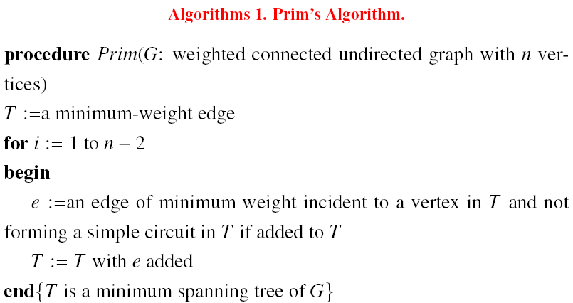

Slide 56
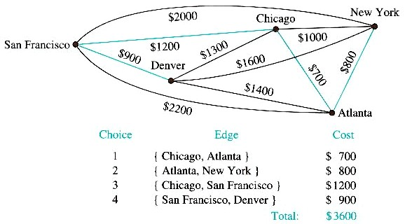
Minimum Spanning Tree

Slide 57
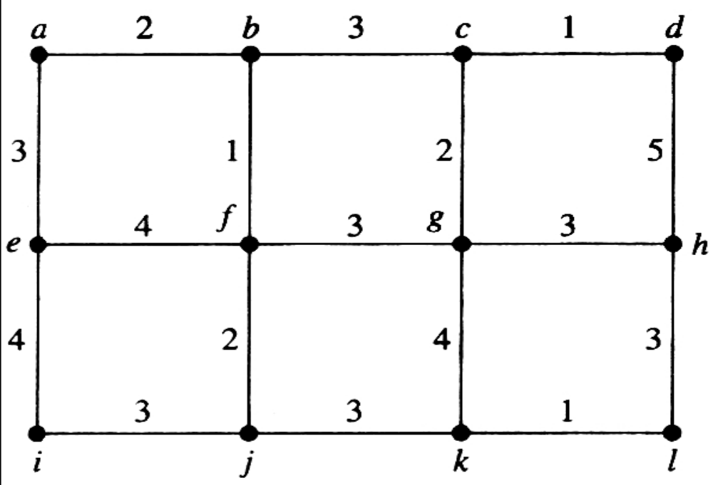
Example Use Prim’s algorithm to find a minimum spanning tree in the graph shown below.

Slide 58
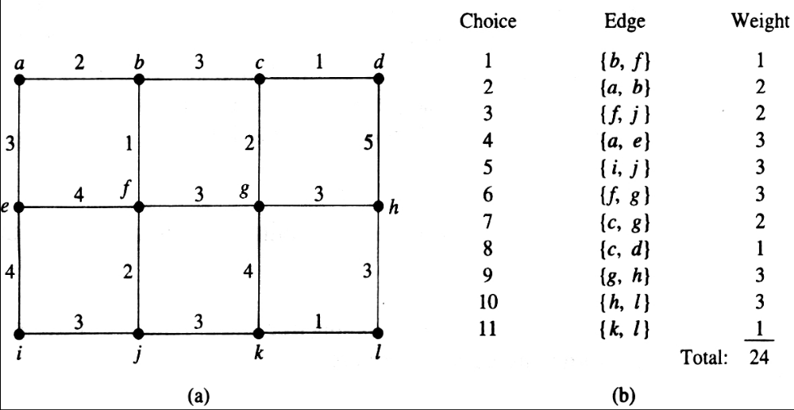
Solution A minimum spanning tree constructed using Prim’s algorithm is shown as follows. The successive edges chosen are displayed.

Slide 59
The second algorithm we will discuss was discovered by Joseph Kruskal in 1956. To carry out Kruskal’s algorithm, choose an edge in the graph with minimum weight.Successively add edges with minimum weight that do not form a simple circuit with those edges already chosen. Stop after n−1 edges have been selected.

Slide 60
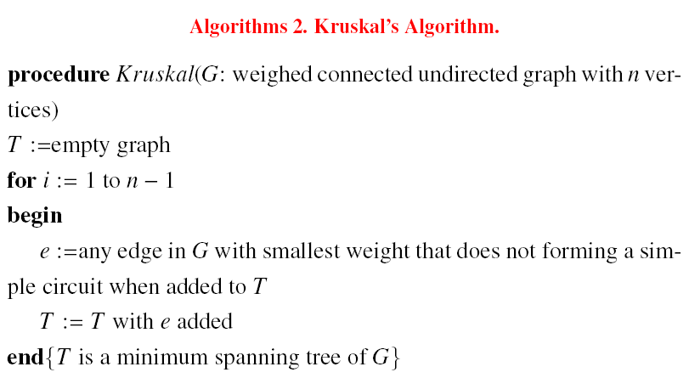

Slide 61
Example Use Kruskal’s algorithm to find a minimum spanning tree in the weighted graph shown below.

Slide 62
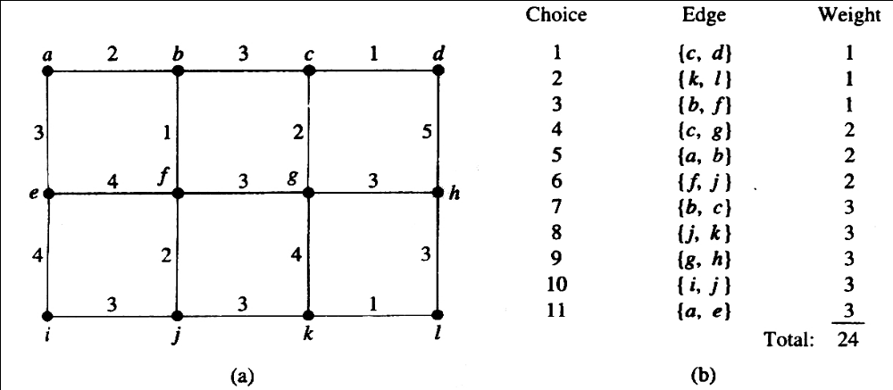
Solution A minimum spanning tree and the choices of edges at each stage of Kruskal’s algorithm are shown as follows.

